Slide 1
Welcome to the District 3 Neighborhood Meeting!
Hosted by:
Vice Mayor Gerard Giudice

Slide 2
Meeting Agenda
Downtown Rohnert Park Update
Homelessness Efforts in Rohnert Park
Economic Development in Rohnert Park
Neighborhood Improvement Projects in District 3
Rohnert Park Creeks Update
Questions
Ways you Can Contact the City

Slide 3
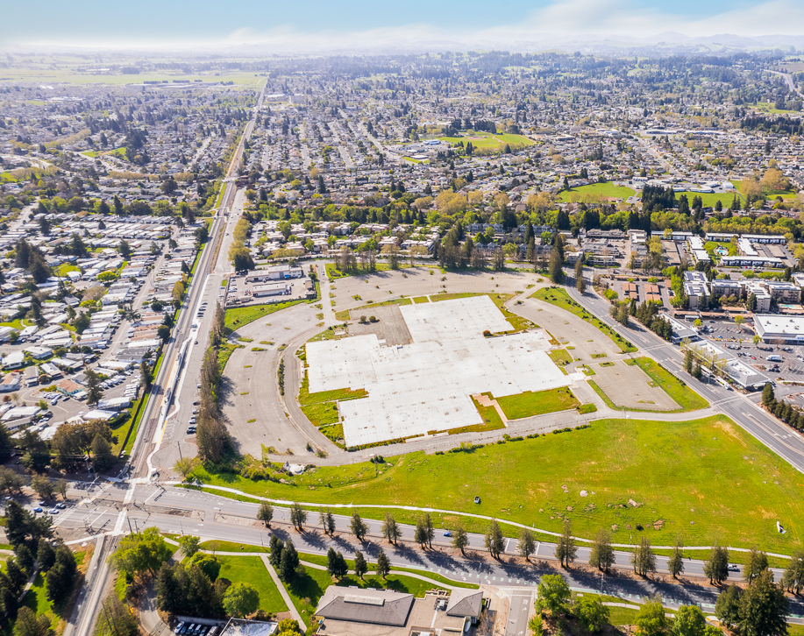
Downtown Rohnert Park Update
Paul Carey
Senior Analyst

Slide 4
Background
City purchased 6400 State Farm Drive property in April 2022
Why is this important? While the property has been vacant since 2010, the City has only recently purchased the property. Prior to 2022, the City could not dictate how or when the property would be developed.
Proactive actions have been taken to offer a “shovel ready” site
Why is this important? Though the City could not take the lead on development, the City’s Development Services section worked through many planning iterations
Extensive community outreach and valuable feedback has been obtained from various stakeholders
Why is this important? This shows that the City has and continues to value feedback from the community.
In December 2022, completed retail market analysis to assess retail feasibility (per study, site can support up to 65,000 sq. ft. of new retail and restaurant space – equating up to 30 new businesses)
Why is this important? Though Rohnert Park has a lot of retail, this analysis shows that the project site can support more retail
Declared and certified property as “Exempt Surplus Land”
Why is this important? Due to California law, public property must go through the Surplus Land Act procedures. Clearing this procedural hurdle is a big deal for development.

Slide 5
Proposed RFQ Schedule
11/30/2023
On-site Project Introduction Meeting
12/21/2023
May/June 2024
March/April 2024
1/8/2024
1/22/2024
Jan/Feb 2024
Deadline for RFQ Questions
RFQ Questions Addendum Released
RFQ Closes
City Review of Developer Qualifications
Interviews with Selected Developers
April/May 2024
Site visits to developer project sites
Potential selection of developer
We are here

Slide 6
Selection Criteria
CATEGORY | SUB-CATEGORY
DEVELOPMENT TEAM EXPERIENCE | Mixed-Use Experience
 | Public/Private Experience
 | Affordable Housing Experience
FINANCIAL CAPACITY | Ability to secure capital
 | Conceptual Pro Forma
PROJECT UNDERSTANDING AND APPROACH | Similar Project Designs
 | Development phasing and schedule
 | Collaborate with City to Create Vibrant Project
LOCAL WORKFORCE PROTECTIONS | Slide 17 in presentation
SUSTAINABILITY | Alignment with City’s plan to mitigate and adapt to climate change
REFERENCES | At least 3 references

Slide 7
Sustainability
Develop an “electrified project” (i.e. limited or no natural gas on site) ✓ Install electric vehicle charging stations
Commitment to purchase Evergreen power from Sonoma Clean Power
Commitment by all commercial tenants to enroll and remain in good standing with Sonoma County Green Business Certification Program
Develop a Vehicle Miles Traveled (VMT) reduction plan or commitment to participate in regional VMT bank
Commitment by construction contractors to have percentage of their fleet powered by electricity or hydrogen rather than fossil fuels
Inclusion of battery storage and/or microgrid in the project

Slide 8
Labor Workforce Protections
Local Hire Goals
Project components funded by public monies will require established local hire goals in the range of 20-25% and establish standardized work rules, hours, and holidays to ensure needs of construction workers are respected and protected. Workplace population would include Sonoma, Marin, Mendocino, Napa, and Lake counties.
Payment of Prevailing Wages
Workforce Compliance Program
Any construction of publicly funded project components, will be subject to payment of prevailing wages and applicable apprenticeship requirements, to make specified health care expenditures for construction craft employees, as well as skilled and trained workforce
Compliance with agreed-upon labor standards
Workforce compliance program ensuring management and documentation of compliance with applicable federal, state, or local laws and regulations, including specific mandates for data security, privacy, and workplace security.
Labor Peace Agreement for “Upscale Hotel” project component
Conceptual plan includes the development of “upscale hotel.” Depending on whether the City maintains a proprietary interest in the site of the hotel, the hotel and on-site restaurant may be subject to a Labor Peace Agreement that requires the hotel to remain neutral and allow access to the workplace at reasonable times to provide for certain organizing functions.
If City maintains proprietary interest in any project components, City will require developer to comply with agreed-upon labor standards including wage, health care, and apprenticeship standards.

Slide 9
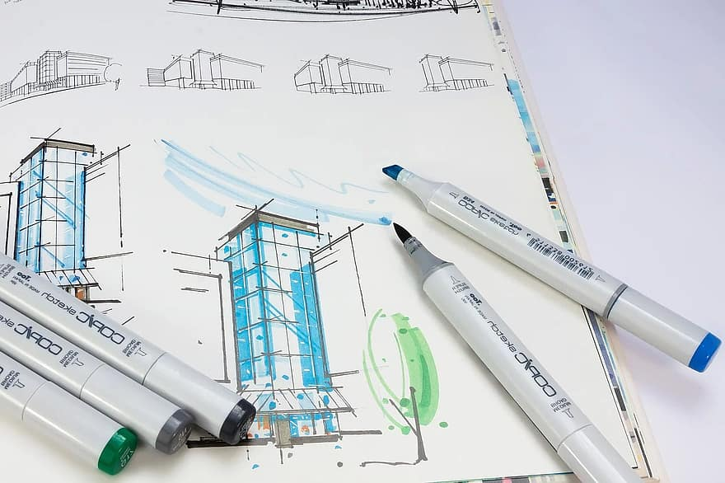
Development Concepts & Renderings
The City has developed a series of development concepts and renderings for Downtown Rohnert Park
Layouts illustrate arrangements of land uses that are also consistent with the Downtown Form Based Code
Site maps are not intended to limit the creativity of development teams
Meant to illustrate the work the City has completed and represent the vision of what a Downtown Rohnert Park could look like

Slide 10
DRAFT – Slavik Designs, LLC - 2023
Notes:
Same thing here, with a little adjustment to the north-south paseo, as well as the configuration of some retail.

Slide 11
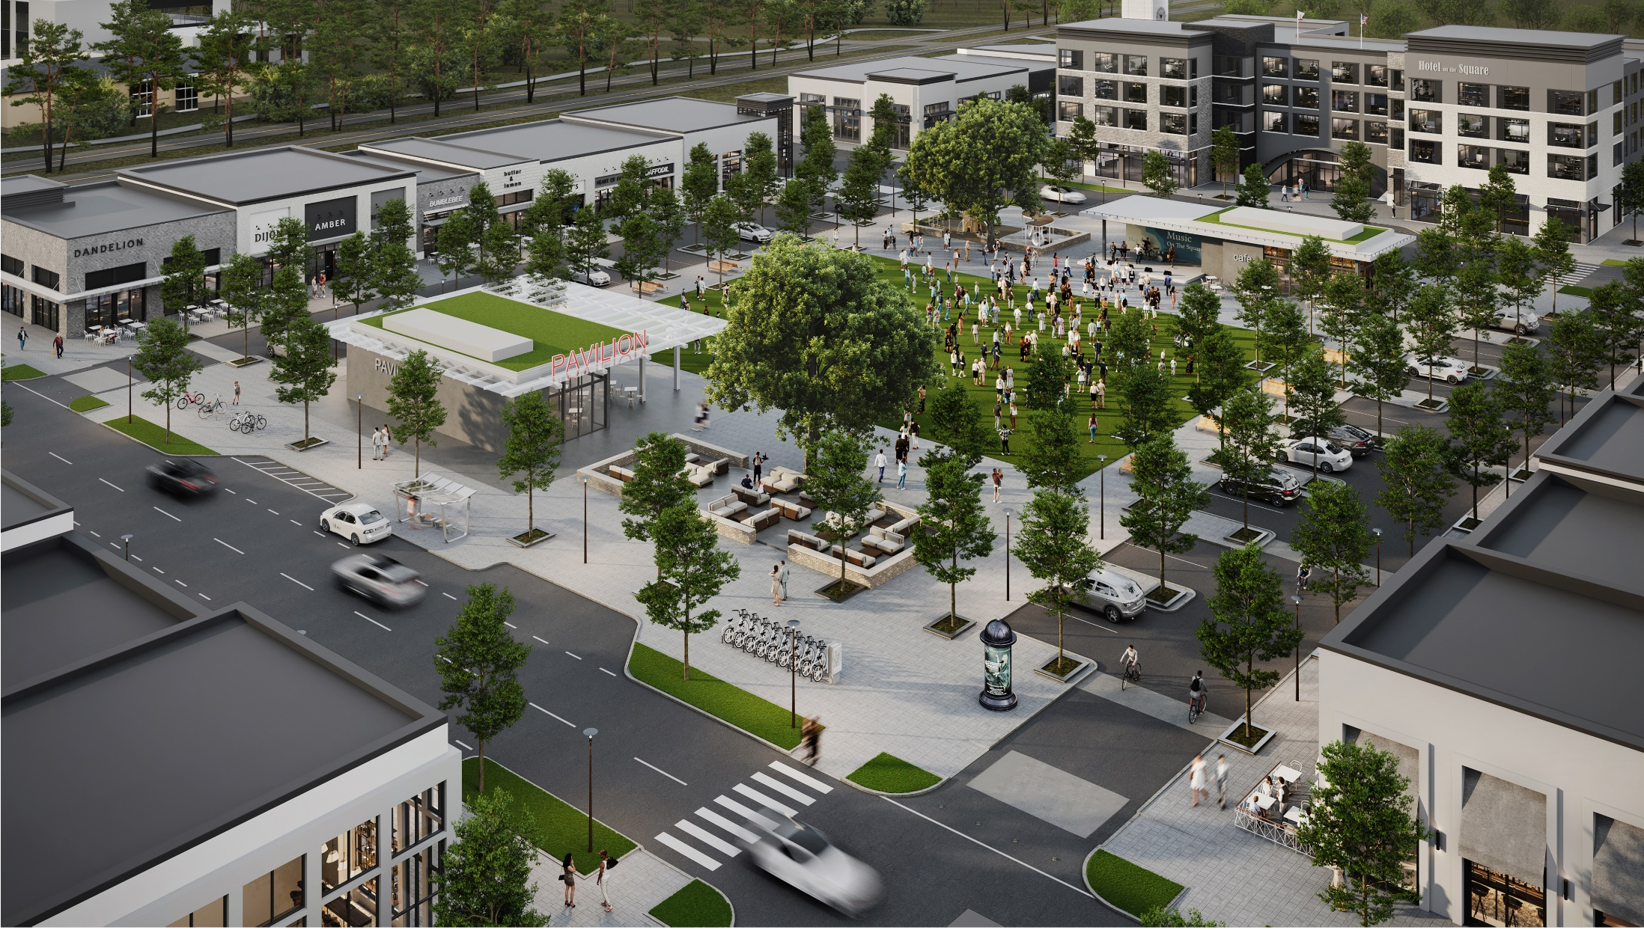
The Community Square “Music on the Square”
CONCEPTUAL

Slide 12
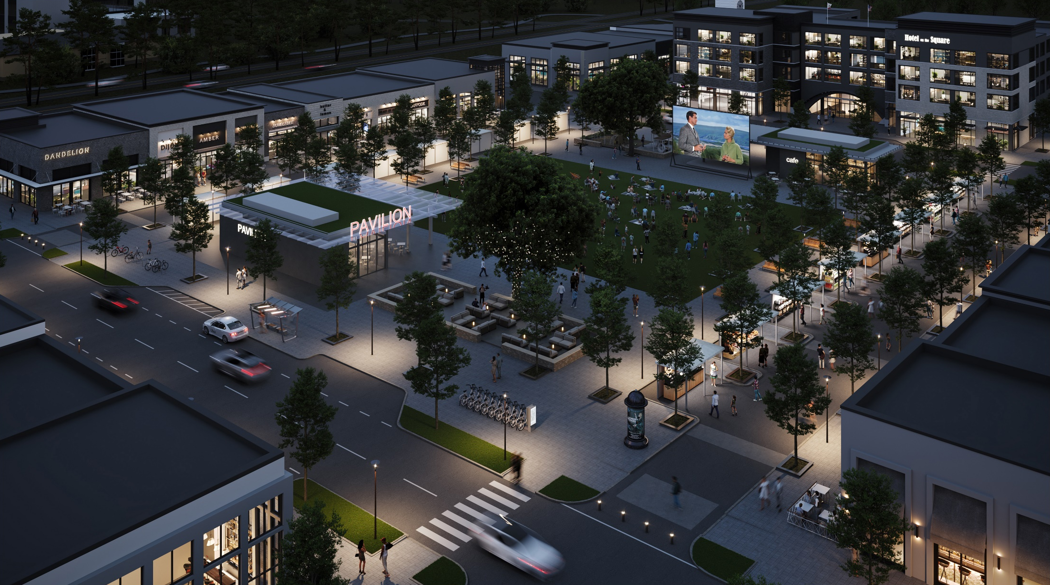
The Community Square “Movie Night and Evening Farmer’s Market”
CONCEPTUAL

Slide 13
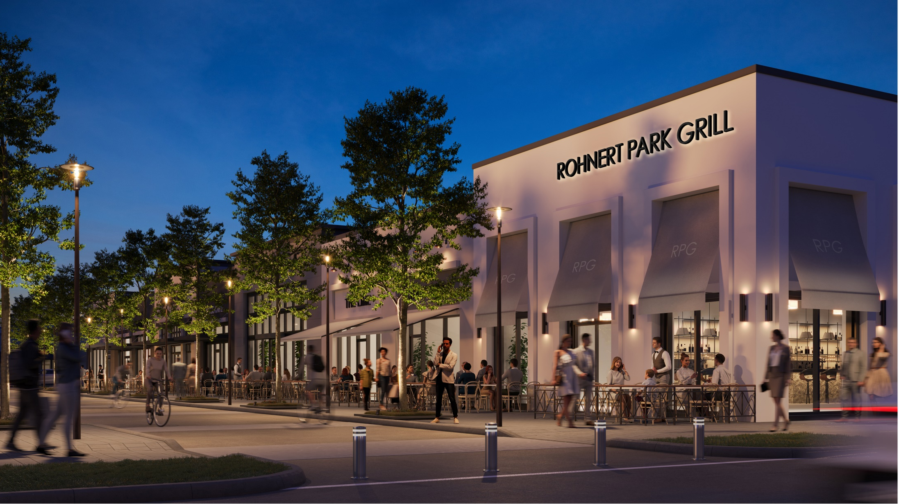
The Retail Core “Sidewalk seating at the Grill”
CONCEPTUAL

Slide 14
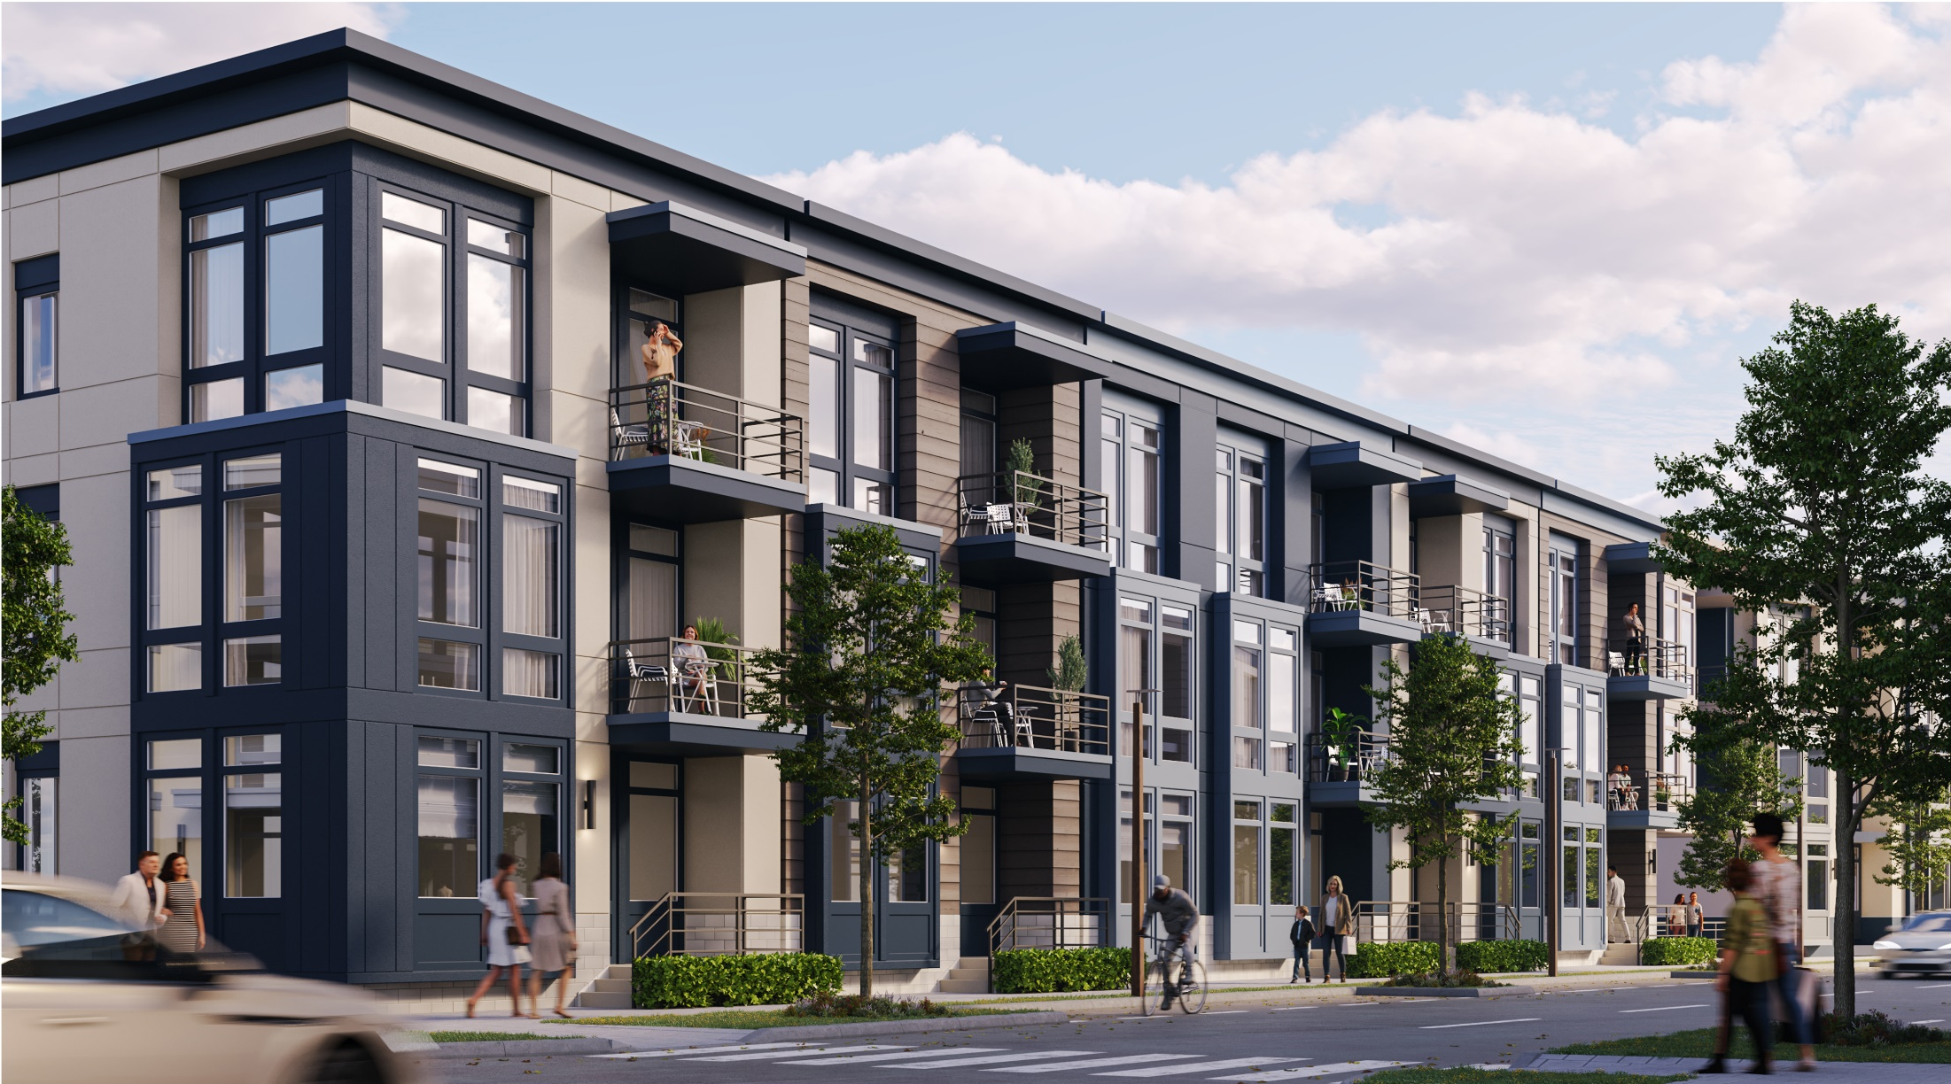
Residential View “Downtown living”
CONCEPTUAL

Slide 15
Initial Feedback – What’s Important to You? Cutoff 3/1/2023
Notes:
This illustrates what is important to survey responders, as of 2/15/2023. We asked respondents what was important to them, and asked them to pick no more than 5 options. This does not mean that the downtown will not have attractive building facades or ample parking, rather, this illustrates that the priority of effort should be the top 5 responses.

Slide 16
Initial Feedback – What’s Important to You? Cutoff 3/1/2023
Notes:
This illustrates what survey responders want to see in the downtown, as of 3/1/2023. We asked them to pick no more than 5 options. This does not mean that the downtown will not have wine tasting rooms or kids stores/activities, rather, this illustrates that the priority of effort should be the top 5 responses.

Slide 17
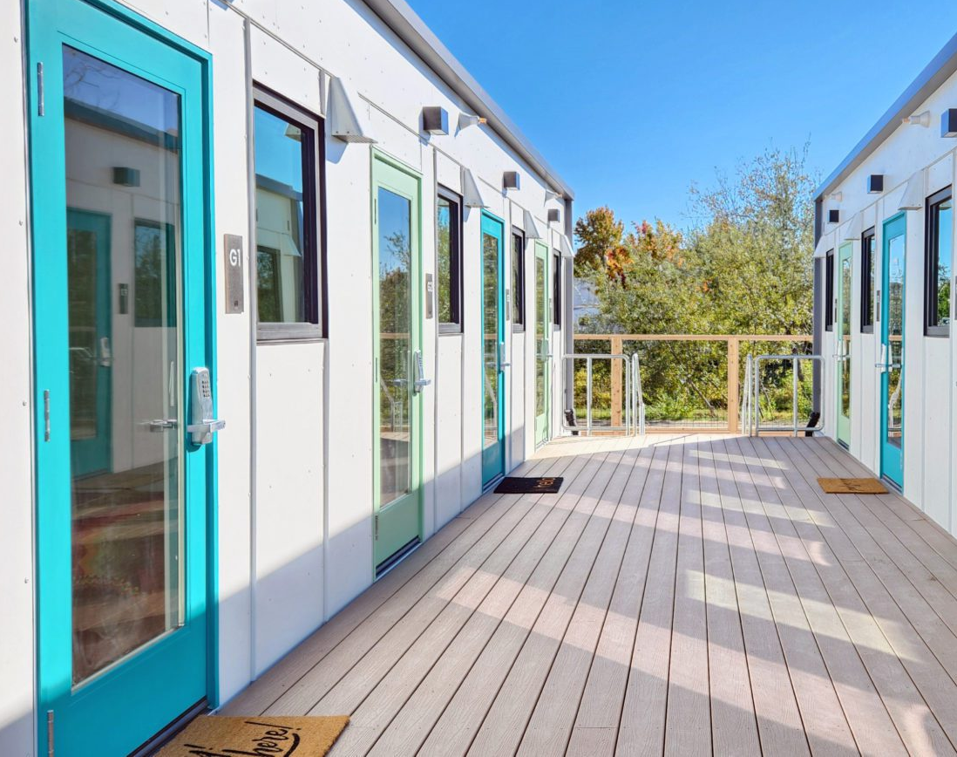
Homelessness Efforts
Jenna Garcia
Housing Manager

Slide 18
Harlee's Story
Notes:
Introduce Harlee – worked in construction for years, worked on SMART tracks. Injury left him unable to work. Became homeless. Homeless in and around RP for years, unable to go into a dorm-style shelter. Waiting lists for other shelters and programs were so long.

Slide 19
City Strategies to Address Homelessness
Short-Term Strategies
Homeless outreach
Enforce and abate encampments which impact public health and safety
Dedicated City staffing
Mid-Term Strategies
Roberts Lake "Safe Sleeping Program"
Labath Landing Interim Housing Program
Service coordination between agencies
Long-Term Strategies
SHARED – Shared Housing Program
Regional Coordination
Master Lease Permanent Supportive Housing

Slide 20
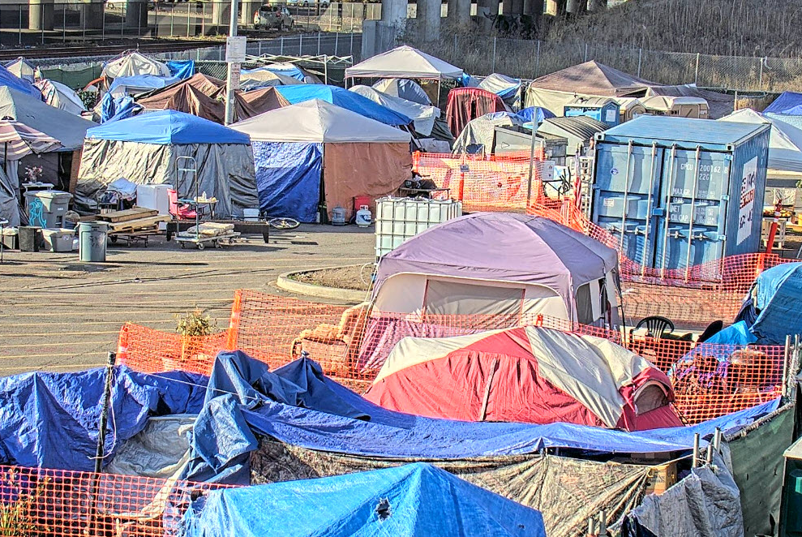
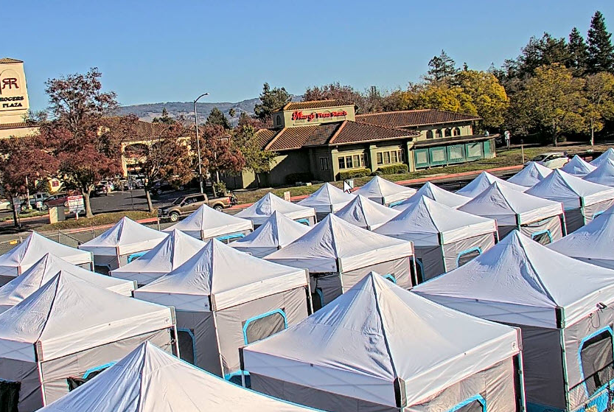
Roberts Lake Park & Ride
Before...
… After
Notes:
The Safe Sleeping Program was set up at Roberts Lake Park & Ride to serve those who were previously camping there in an unmanaged encampment. The City set up tents and platforms, with fire lanes, and provides trash service and portable toilets. The City also pays for 24/7 security and services to help the individuals living there move into interim and permanent housing. The goal is to wind down the program as the last of the residents move out.

Slide 21
Roberts Lake Safe Sleeping Program Roster
Notes:
Over the time the program has been open, we have seen a lot of success. The total roster has reduced significantly as people have moved out. Of those who have left the program, 48% have moved into interim or permanent housing. There are 8 people remaining in the program who we are working with to move into interim and permanent housing.

Slide 22
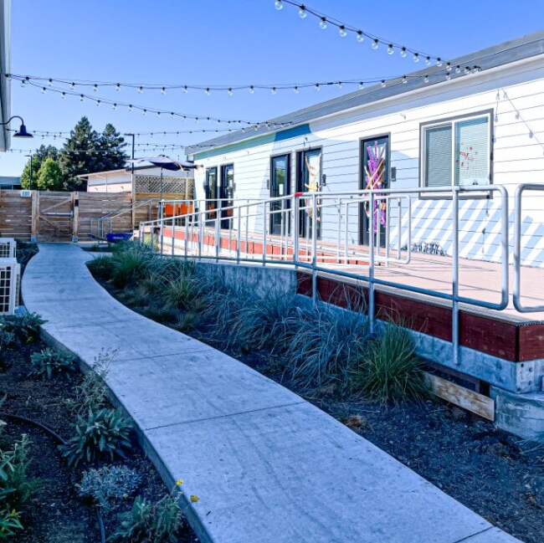
Labath Landing
Opened on October 24, 2022
108 people served
43 people moved out
Of those, 18 (41%) moved into permanent housing

Slide 23
Harlee's Story
Notes:
Continuation/Conclusion of When Labath Landing opened, Harlee was one of the first to move in. In May, he moved into his own apartment through the City's master lease PSH program, which helps pay for his rent and provides ongoing case management to help him maintain his housing long-term.

Slide 24
Key Homeless Services Outcomes Jan 1, 2021 – Dec 31, 2023
**Please note there is some overlap between these numbers. For example, someone who accesses shelter may later be housed through a City-funded permanent housing program.**

Slide 25
Economic Development
Kevin King
Senior Analyst, Economic Development

Slide 26
Shifting from Reactive to Proactive
Reaffirming "Economic Development" in Rohnert Park
Communicating with commercial and business stakeholders
Building Protocols and Analytics

Slide 27
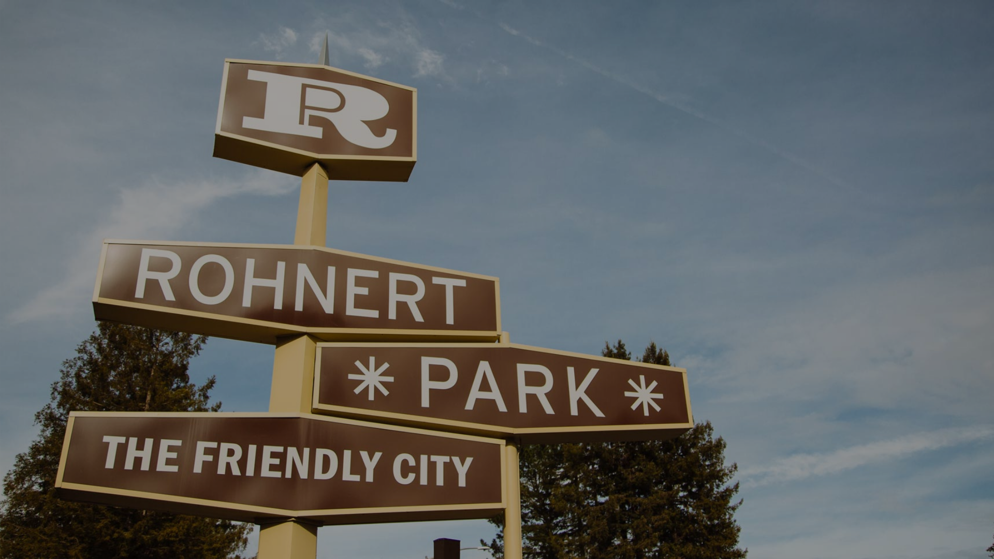
Reaffirming Economic Development
Finalizing the economic development element in the updated general plan
Re-establishing the Economic Development Ad Hoc Committee

Slide 28
Communicating with Stakeholders
Connecting Rohnert Park businesses to finance and local, state, and federal opportunities and programs
Problem solving development with commercial property owners and local commercial brokers and managers
Building relationships with the Sonoma County Economic Development Board and team
Reach out to regional and national businesses to Rohnert Park

Slide 29
Building Protocols
Creating our data and analytics systems
Creating a pipeline of businesses interested in Rohnert Park
Establishing methods for Rohnert Park businesses to grow
Regularly review established ordinances and research new laws to better streamline processes for Rohnert Park businesses and entrepreneurs interesting in staring in the City
Highlight Successes

Slide 30
How Does District 3 compare
Commercial real estate vacancy rates
 | Rohnert Park | District 3
Retail | 6.65% | 1.83%
Office | 13.22% | 6.98%
Total | 7.84% | 4.83%
Multifamily occupancy and cost
 | Rohnert Park | District 3
Occupancy | 94.94% | 96.81%
Rent per unit | $1,902 | $1,723

Slide 31
Itinerary for 2024
Retail recruitment for the new downtown
Examine costs and cost reductions associated with developing the downtown
Review microenterprises
Revamp to tourism efforts
Assist in filling prominent vacancies across the city
Bear Republic
Movie theater
Continue to build out data systems to help staff make informed decisions
Spotlight prominent businesses in Rohnert Park (Instagram: @rohnertparkcity)
Trader Joes! Trader Joes! Trader Joes!

Slide 32
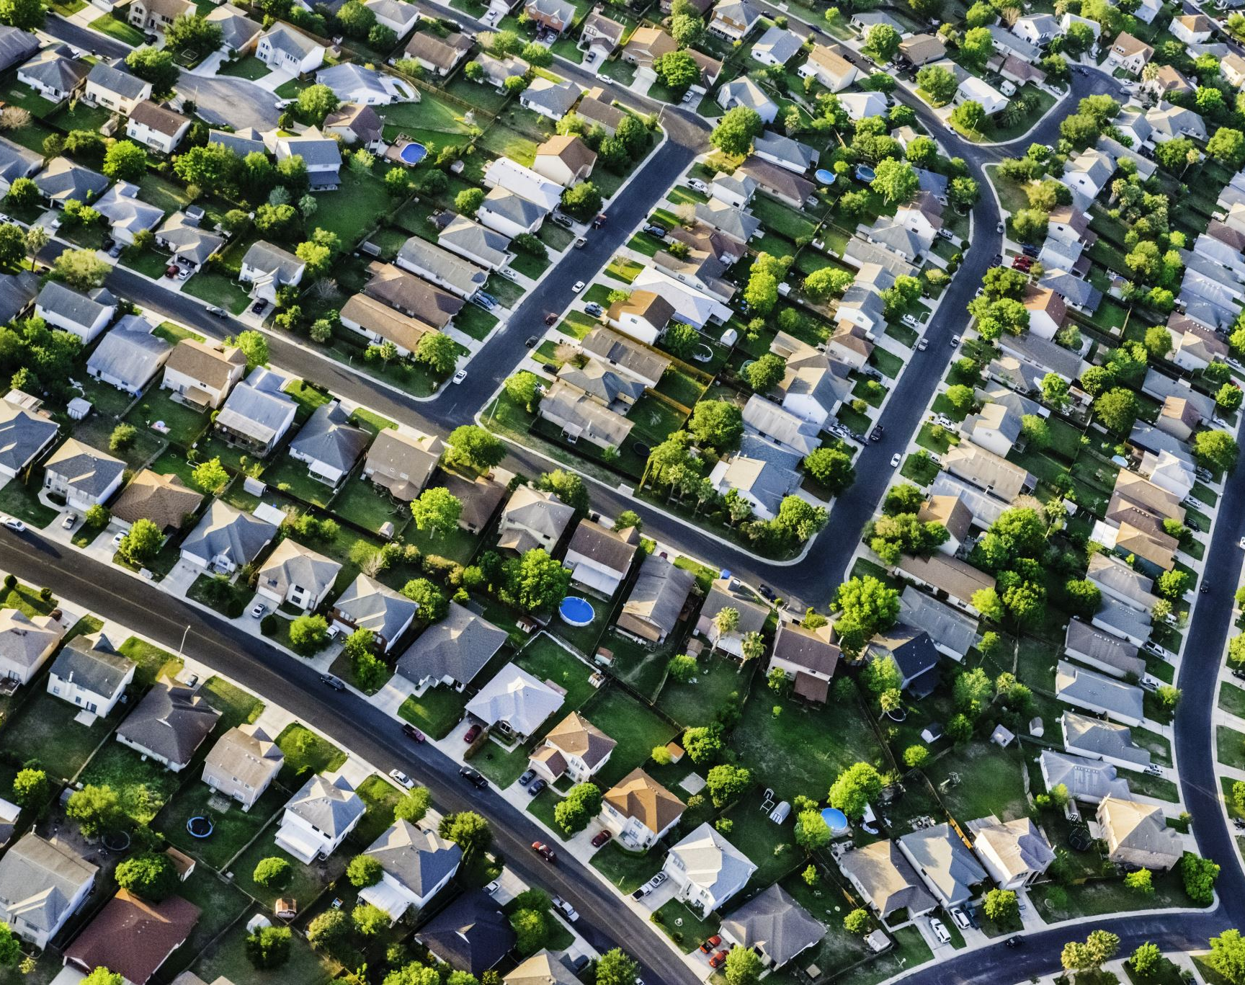
Neighborhood Public Improvements C, J, O, K Neighborhoods (District 3)
Vanessa Garrett
Public Works Director

Slide 33
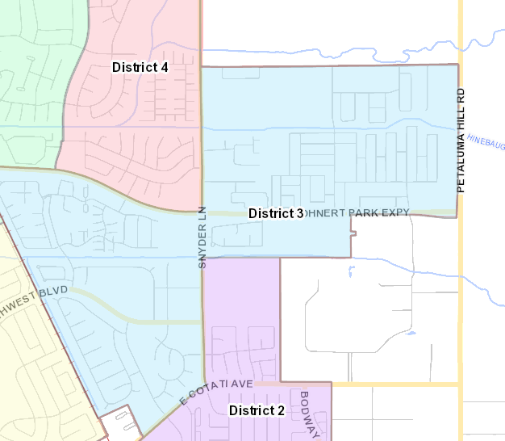
Projects happening throughout all of District 3:
-Water meter replacement project
-Parks and Recreation Master Plan

Slide 34
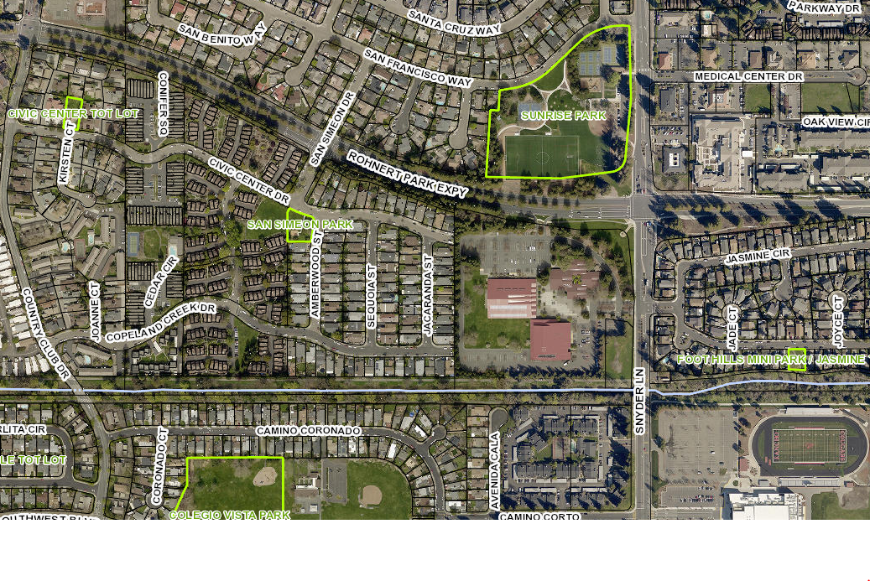
Flashing Yellow Arrow (San Simeon/RPX)
Crosswalk enhancements @ Copeland Creek/ Country Club
Crosswalk enhancements @ Copeland Creek/ Snyder

Slide 35
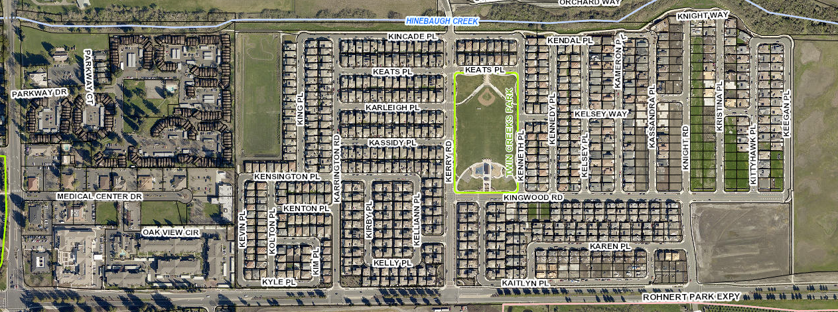
Re-pave creek path from Snyder Lane to K Section
New crosswalk at Snyder Lane and Copeland Creek
Replacing flashing beacons at Snyder Ln

Slide 36
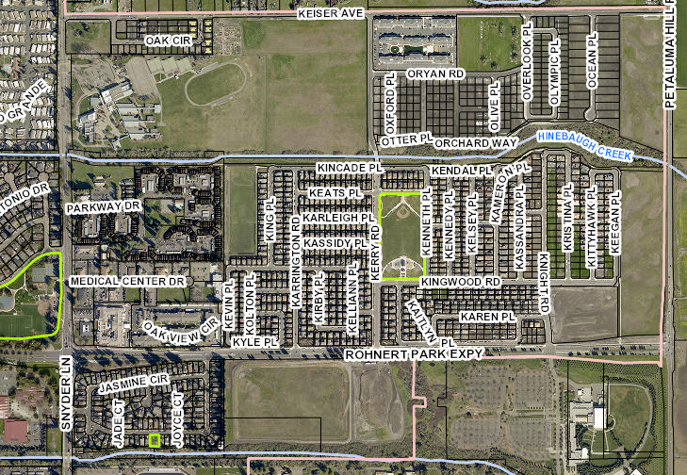
Keiser Avenue/Snyder Signal Install
Tank 3 Well System Seismic Retrofit

Slide 37
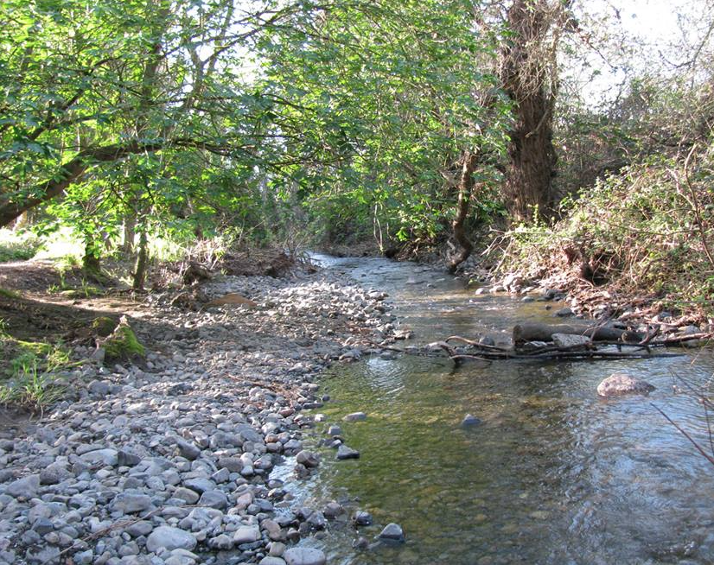
Rohnert Park Creeks Update
Vanessa Garrett
Public Works Director

Slide 38
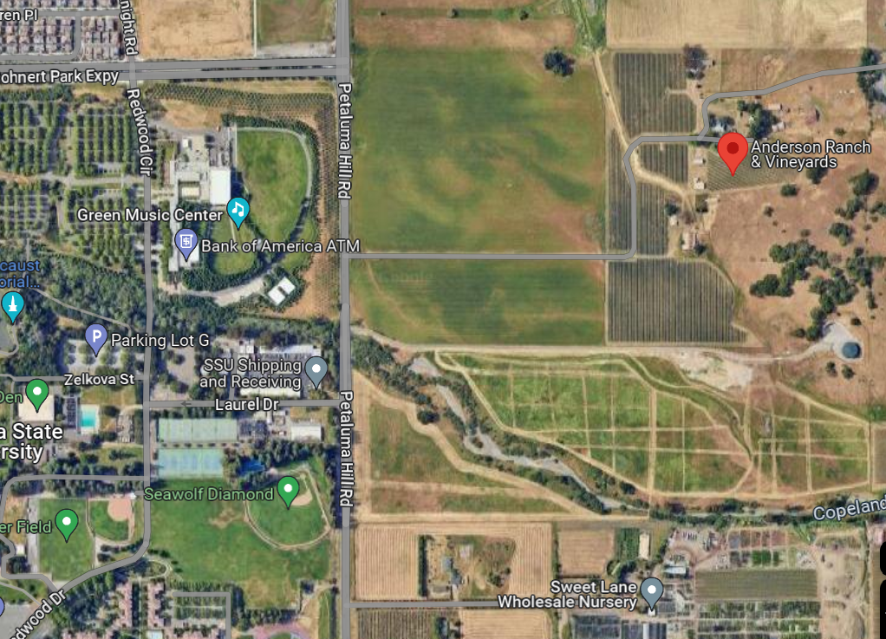
Copeland Creek Detention Basin

Slide 39
Flood Prevention Efforts
We have been working on a flood detention basin for Copeland Creek, which will relieve the sediment issues which can often lead to flooding
This is being done in partnership with the developer of the University Development.
The Copeland Creek flood detention basin will provide additional flood prevention for the district and the City.

Slide 40
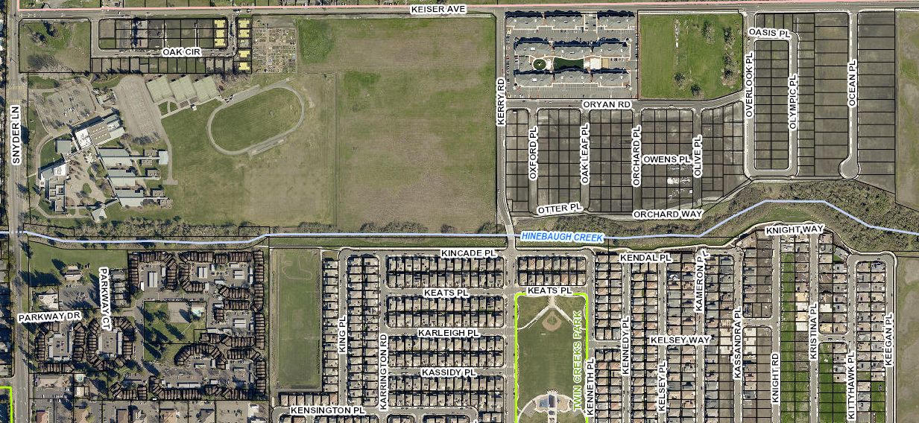
Stormwater and Vegetation Management District 3 Activities
Vegetation management on Keiser Ave from Overlook Place to Petaluma Hill road (annually)
Hinebaugh Creek maintenance along Hinebaugh Creek from Snyder to King Pl (3x per year)

Slide 41
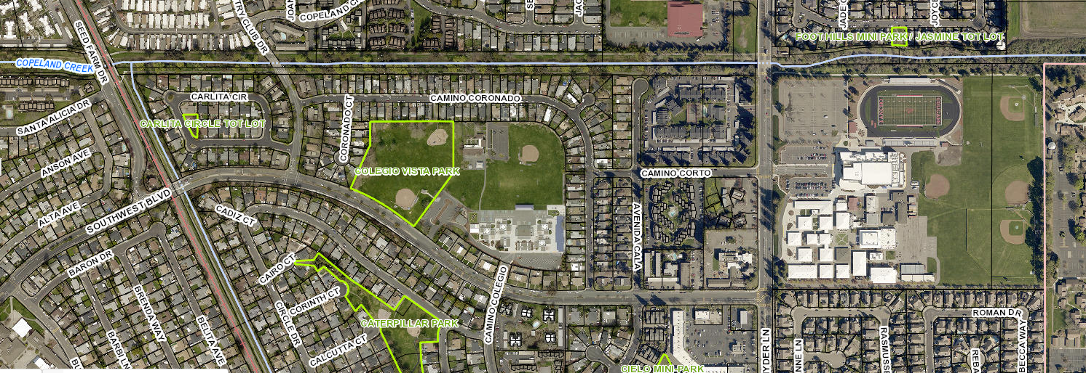
Stormwater and Vegetation Management District 3 Activities (continued)
Copeland Creek maintenance along Copeland Creek from Seed Farm Drive to Well 3 (Jasmin Ct) (3x per year)
Clearing Copeland Creek Extension (special project) from Seed Farm Drive to Carlita Circle – cleared outfalls, removed trees, cleared debris and overgrown vegetation

Slide 42
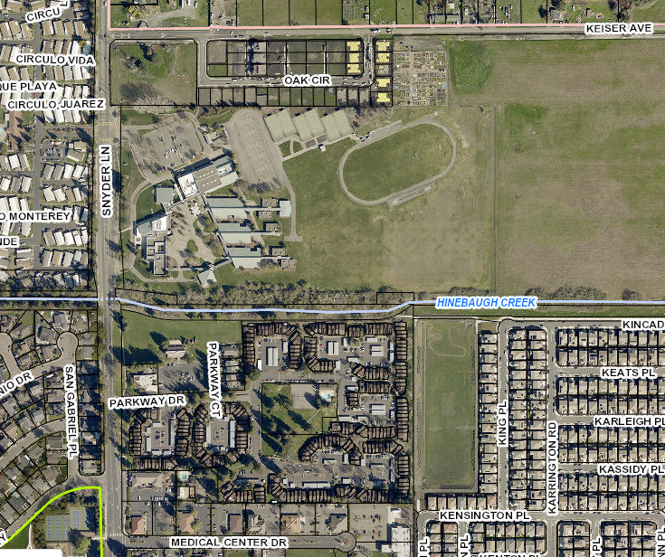
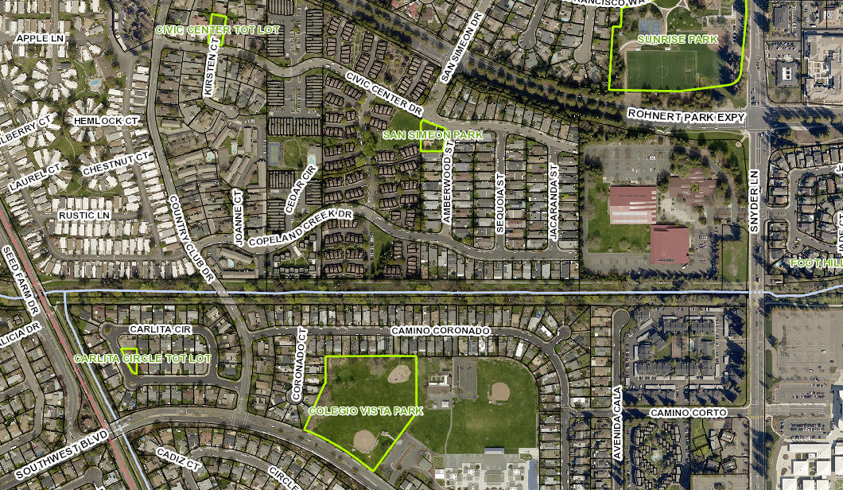
Streets Maintenance Activity in District 3
Snyder Ln from Keiser Ave to Medical Center Drive
Country Club Dr from RPX to Southwest Blvd
Copeland Creek Drive
Civic Center Drive
Southwest Blvd from Seed Farm to Colegio Vista Park

Slide 43
Griffin’s Grove Update

Slide 44
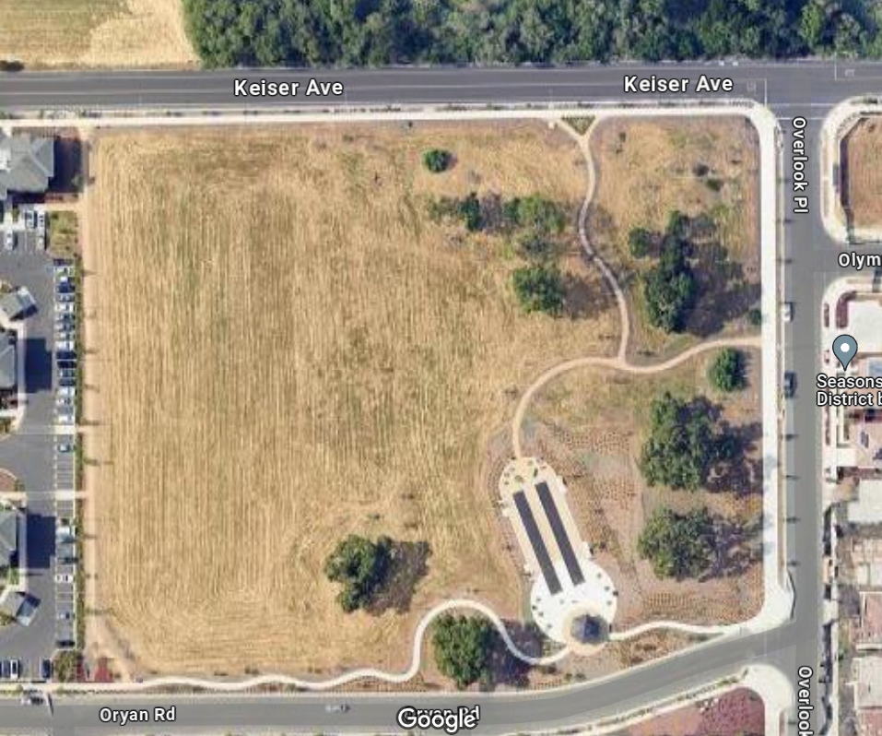
Walkway
Natural Preservation Area
Bocce Courts

Slide 45
Questions?

Slide 46
Questions
What is the plan for parking on the downtown project?
There are approximately 1,140 parking spaces on the 30-acre project site. The parking calculations were done using the Metropolitan Transportation Commission (MTC) Transit Oriented Communities (TOC) guidelines.
We are looking to add more parking by reconfiguring State Farm Drive and Enterprise Drive to allow parking.
Future parking considerations will be discussed with a developer once we have chosen a developer.
How many people do you expect will come to Downtown Rohnert Park?
It’s impossible to predict with any certainty how popular Downtown Rohnert Park will be, but we can look at traffic counts around the area to get an idea of how many people drive in Central Rohnert Park.
28,348 vehicles on average per day travel on Rohnert Park Expressway (from Country Club to Redwood Drive)
10,040 vehicles travel on Commerce Blvd (from Southwest to Golf Course) per day
6,050 vehicles travel on Enterprise Drive per day
25,100 vehicles travel on Golf Course Drive per day\
What is the retail vacancy for Rohnert Park?
Retail - 6.65%
Office - 13.22%
Total - 7.84%
How will downtown have good retail to attract people when Santa Rosa and Petaluma already have downtown retail options?
Our plan is to have a high quality downtown built with Class A retail properties. Class A properties represent the highest quality buildings in their market and area. They are generally newer properties built within the last 15 years with top amenities, high-income earning tenants and low vacancy rates. Class A buildings are well-located in the market and are typically professionally managed. Additionally, they typically demand the highest rent with little or no deferred maintenance issues.
That, coupled with the amenities that are planned for the downtown (community square, et al), will draw people to the downtown development.

Slide 47
Questions
Who maintains the footbridge on the Copeland Creek trail between Golf Course Drive and Snyder Blvd?
Pedestrian footbridges through out the city are maintained either by the water agency or our local public works department, depending on location. Please contact the public works department at 707-588-3300 if you have any questions regarding these bridges, and we can either answer or direct residents to the proper agency.
Can the City do anything about the wild turkeys roaming around Rohnert Park? Their feces and presence in neighborhoods is starting to be disruptive.
We currently do not have an ordinance that deals with wild turkeys, but we can investigate potential solutions.
Who is responsible for Copeland Creek maintenance?
That is a Public Works responsibility.
When will the playground on Civic Center Drive be fixed? The playground has been roped off since sometime in November stating that maintenance is required.
The issue we are running into is the age of the equipment. Replacement parks have been ordered, but due to the age of the play structure, they are hard to come by. We are working on ways to get the playground back up and running.

Slide 48
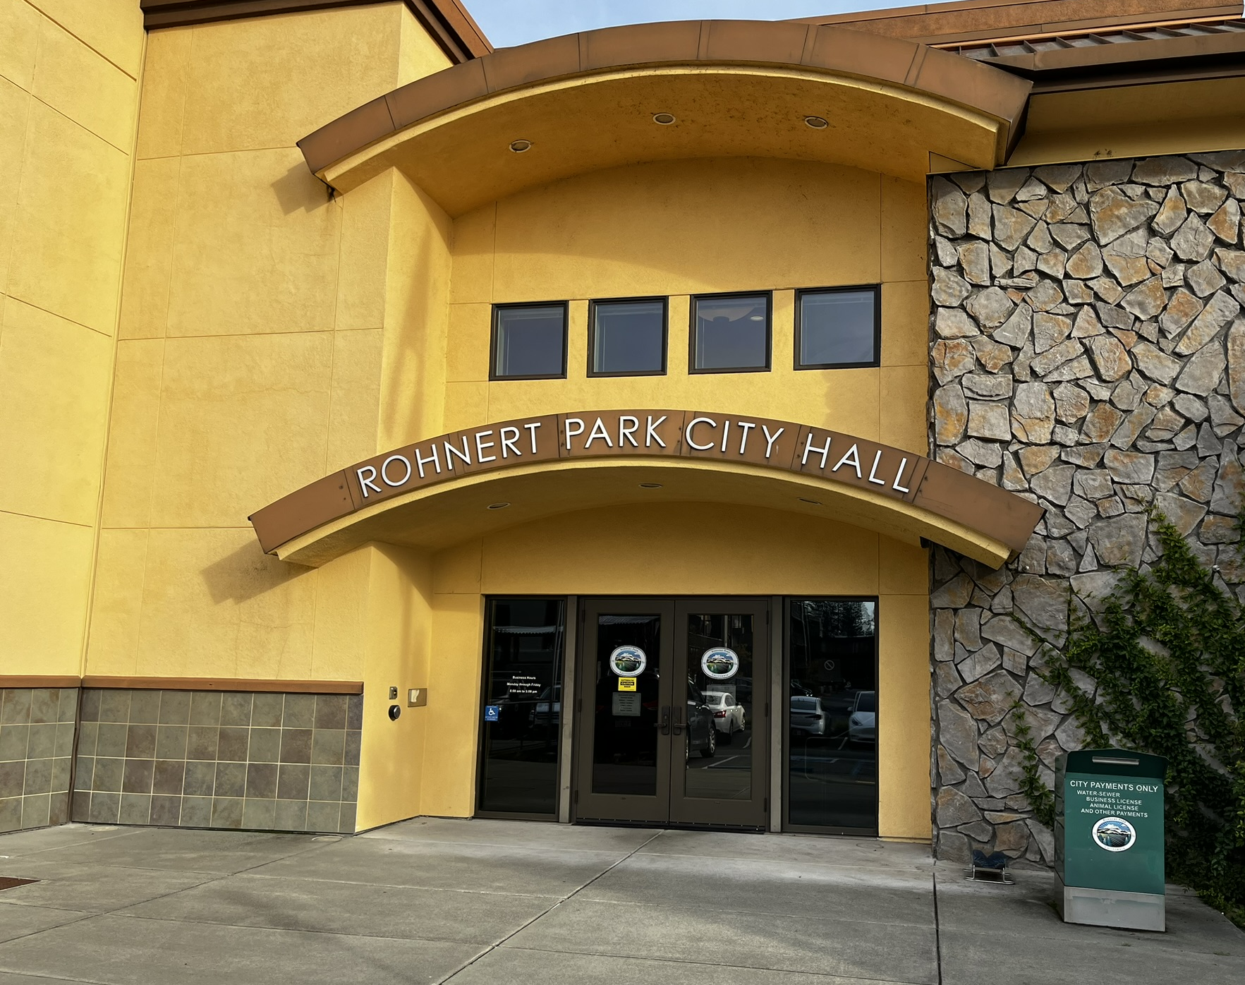
Ways You Can Contact the City

Slide 49
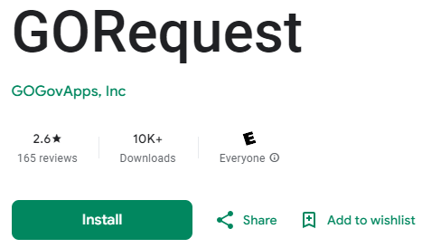
Contacting the City
Reach Rohnert Park! - on the City Webpage, under “Report a Concern” https://bit.ly/RohnertParkConcerns
2. Public Safety Non-Emergency Line:
707.584.2600
3. E-mail or call your local councilmember: https://bit.ly/MeetMyCityCouncil
4. Download the GORequest app for Apple or Android

Slide 50
Contacting the City
E-mail or Call City staff
Section | E-Mail/Phone
Main City Hall Line | 707-588-2226 - admin@rpcity.org
Public Works | 707-588-3300
Community Services | 707-588-3456
Development Services - Planning | 707-588-2231 - Planning@rpcity.org
Code Compliance | 707-588-2249 - code@rpcity.org
Development Services - Building | 707-588-2240 – building@rpcity.org
Public Safety – Nonemergency | 707-584-2600 – psafety@rpcity.org

